Slide 1
111-2 MIS241
0215 Week1

Slide 2
Outline
Syllabus review
Introduction of data resource
Introduction of dplyr
Sampling distribution application in R
0215-lab

Slide 3
Syllabus review

Slide 4
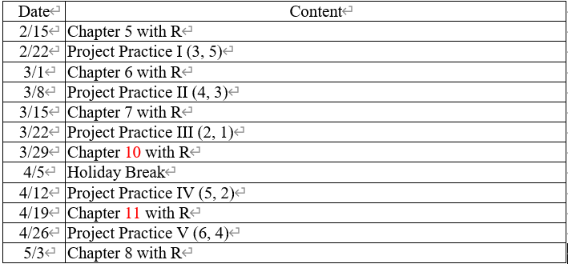
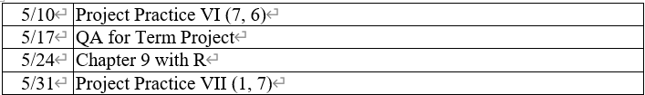
Syllabus of this course
Notes:
d

Slide 5
Grading policy
Project practice 60%
Labs 30%
In-class participation 10%

Slide 6
TA info
焦玉茹 jill871007@gmail.com
蔡瑋駿 chris19151237@gmail.com

Slide 7
Data resource

Slide 8
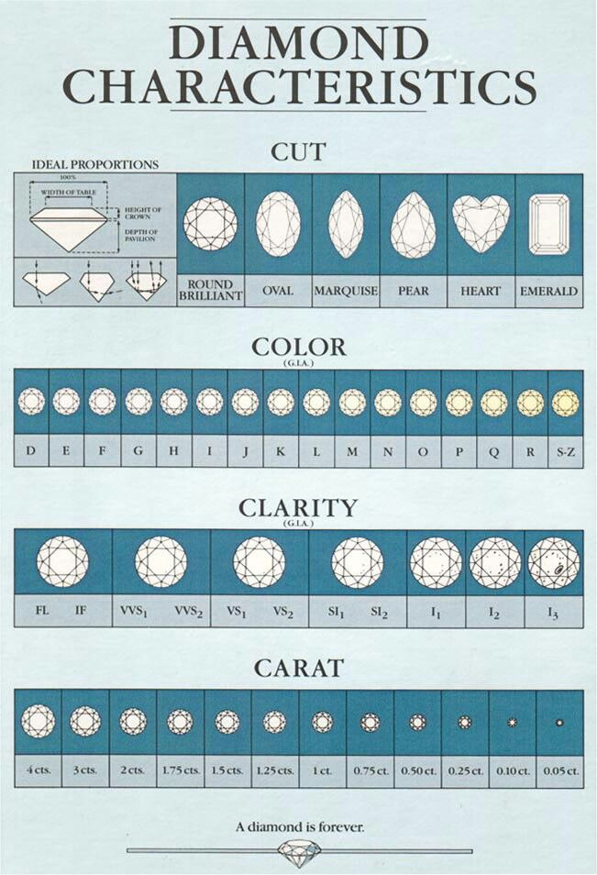
Diamond.csv from Kaggle
欄位名稱 | 欄位說明
carat | unit of weight for stones
cut | stone shape score in terms of "usability" or power of selling
color | the international "Diamond Color Scale". its based on the transparency grade
clarity | the international "Diamond Clarity Scale". its based on the number of impurities
depth | percentage format of z / x. it's a common parameter in the industry
table | percentage format of z / a certain variable not present in the dataset. it's a common parameter in the industry
price | USD price
x,y,z | x,y,z dimension in millimetres
Notes:
全部資料量約5.4萬
clarity → impurities

Slide 9
Introduction of dplyr

Slide 10
Properties of dplyr
協助資料分析
融入與SQL相仿的函數

Slide 11
Dplyr installation
於指令區輸入： install.packages(“dplyr”) library(“dplyr”)

Slide 12
The main functions of dplyr
filter() | 篩選符合條件的觀測值
select() | 選擇變數
mutate() | 新增變數
arrange() | 依照變數排序觀測值
summarise() | 聚合變數
groupby() | 依照類別變數分組、搭配

Slide 13
Sampling distribution application in R

Slide 14
0215 lab

Slide 15
Some rules
Snapshot your code as well as the results to WORD
Save the file as PDF
Hand over the file to CU in limited time

